Slide 1
Review: Linear Programming and Reduction-II

Slide 2
Flows in networks

Slide 3
A closer look at the algorithm
All we know so far of the simplex algorithm is the vague geometric intuition that it keeps making local moves on the surface of a convex feasible region, successively improving the objective function until it finally reaches the optimal solution.
The behavior of simplex has an elementary interpretation:
Start with zero flow.
Repeat: choose an appropriate path from s to t, and increase flow along the edges of this path as much as possible.

Slide 4
A closer look at the algorithm (cont’d)
There is just one complication.
What if we choose a path that blocks all other paths?
Simplex gets around this problem by also allowing paths to cancel existing flow.
To summarize, in each iteration simplex looks for an s -t path whose edges (u, v ) can be of two types:
(u, v ) is in the original network, and is not yet at full capacity.
The reverse edge (v, u) is in the original network, and there is some flow along it.
If the current flow is f , then in the first case, edge (u, v ) can handle up to cuv − fuv additional units of flow, and in the second case, up to fvu additional units (canceling all or part of the existing flow on (v, u)).

Slide 5
A closer look at the algorithm (cont’d)
These flow-increasing opportunities can be captured in a residual network G^{f} = (V , E ^{f} ), which has exactly the two types of edges listed, with residual capacities c^{f} :
cuv − fuv if (u, v ) ∈ E and fuv < cuv
fvu
if (v, u) ∈ E and fvu > 0.
Thus we can equivalently think of simplex as choosing an s -t path in the residual network.
By simulating the behavior of simplex, we get a direct algorithm for solving max-flow.
It proceeds in iterations, each time explicitly constructing G^{f} , finding a suitable s -t path in G^{f} by using, say, a linear-time breadth-first search, and halting if there is no longer any such path along which flow can be increased.

Slide 6
Cuts
A truly remarkable fact:
not only does simplex correctly compute a maximum flow, but it also generates a short proof of the optimality of this flow!
An (s, t)-cut partitions the vertices into two disjoint groups L and R such that s ∈ L and t ∈ R . Its capacity is the total capacity of the edges from L to R , and as argued previously, is an upper bound on any flow:
Pick any flow f and any (s, t)-cut (L, R ),
then size(f ) ≤ capacity(L, R ).

Slide 7
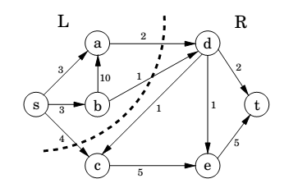
Cut

Slide 8
A certificate of optimality
Theorem (Max-flow min-cut)
The size of the maximum flow in a network equals the capacity of the smallest
(s, t)-cut.
Proof.
Suppose f is the final flow when the algorithm terminates.
We know that node t is no longer reachable from s in the residual network G^{f} . Let L be the nodes that are reachable from s in G^{f} , and let R = V \ L be the rest of the nodes. We claim that
size(f ) = capacity(L, R )
To see this, observe that by the way L is defined, any edge going from L to R must be at full capacity (in the current flow f ), and any edge from R to L must have zero flow.
Therefore the net flow across (L, R ) is exactly the capacity of the cut.

Slide 9
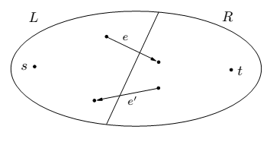
Max-flow min-cut

Slide 10
Efficiency
Each iteration of our maximum-flow algorithm is efficient, requiring O(|E |) time if a DFS or BFS is used to find an s -t path.
But how many iterations are there?
Suppose all edges in the original network have integer capacities ≤ C .
Then on each iteration of the algorithm, the flow is always an integer and increases by an integer amount. Therefore, since the maximum flow is at most C |E |, the number of iterations is at most this much.
If paths are chosen in a sensible manner – in particular, by using a BFS, which finds the path with the fewest edges – then the number of iterations is at most O(|V | · |E |), no matter what the capacities are.
This latter bound gives an overall running time of O(|V | · |E |²) for maximum flow.

Slide 11
Bipartite matching

Slide 12
The problem
A graph with nodes on the left representing boys and nodes on the right representing girls.
There is an edge between a boy and girl if they like each other.
Is it possible to choose couples so that everyone has exactly one partner, and it is someone they like?
In graph-theoretic jargon, is there a perfect matching?

Slide 13
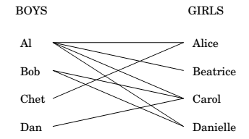
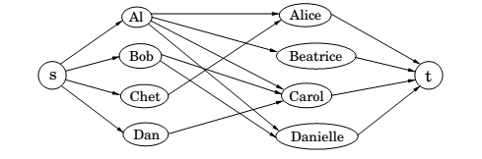
Bipartite matching

Slide 14
Duality

Slide 15
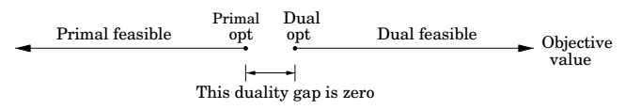
The dual program
min 200 y₁ + 300 y₂ + 400 y₃
y₁ + y₃ ≥ 1
y₂ + y₃ ≥ 6
y₁, y₂, y₃ ≥ 0
By design, any feasible value of this dual LP is an upper bound on the original primal LP. So if we somehow ﬁnd a pair of primal and dual feasible values that are equal, then they must both be optimal. Here is just such a pair:
Primal: (x₁, x₂) = (100,300);
Dual: (y₁, y₂, y₃ ) = (0,5,1).
They both have value 1900, and therefore they certify each other’s optimality.

Slide 16

A generic primal LP in matrix-vector form and its dual
Primal LP: Dual LP:
max c^{T}x min y^{T}b
Ax $≤$ b y^{T} A $≥$ c^{T}
X $≥$ 0 y $≥0$
Theorem (Duality)
If a linear program has a bounded optimum, then so does its dual, and the two optimum values coincide.

Slide 17
Zero-sum games

Slide 18
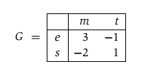
Presidential election
There are two candidates for oﬃce, and the moves they make correspond to campaign issues on which they can focus (the initials stand for economy, society, morality, and tax cut).
The payoﬀ entries of G are millions of votes lost by Column.

Slide 19
Pure strategy
Suppose Row announces that she will play the mixed strategy
x = (1/2,1/2). What should Column do?
Move m will incur an expected loss of 1/2, while t will incur an expected loss of 0. The best response of Column is therefore the pure strategy y = (0,1).
More generally, once Row’s strategy x = (x₁, x₂) is ﬁxed, there is always a pure strategy that is optimal for Column:
either move m, with payoﬀ 3x₁ − 2x₂, or t, with payoﬀ −x₁ + x₂, whichever is smaller.

Slide 20
Pure strategy (cont.)
Therefore, if Row is forced to announce x before Column plays, she knows that his best response will achieve an expected payoﬀ of min{3x₁ − 2x₂,−x₁ + x₂}. She should choose x defensively to maximize her payoﬀ against this best response:
Pick (x₁,x₂) that maximizes min{3x₁ − 2x₂, −x₁ + x₂}.

Slide 21
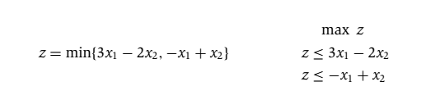
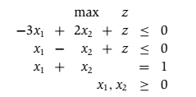
LP formulation
Row needs to choose x₁ and x₂ to maximize this z.

Slide 22
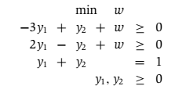
LP formulation (cont’d)
Symmetrically, if Column has to announce his strategy ﬁrst, his best bet is to choose the mixed strategy y that minimizes his loss under Row’s best response:
Pick (y₁, y₂) that minimizes max{3y₁ − y₂, −2y₁ + y₂}.
In LP form:
These two LPs are dual to each other (see Figure 7.11)! Hence, they have the same optimum, call it V.

Slide 23
Value of the game
By solving an LP, Row (the maximizer) can determine a strategy for herself that guarantees an expected outcome of at least V no matter what Column does.
And by solving the dual LP, Column (the minimizer) can guarantee an expected outcome of at most V , no matter what Row does.
It follows that this is the uniquely deﬁned optimal play:
a priori it wasn’t even certain that such a play existed.
V is known as the value of the game
In our example, it is 1/7 and is realized when Row plays her optimum mixed strategy (3/7,4/7) and Column plays his optimum mixed strategy (2/7,5/7).

Slide 24

Min-max theorem of games
This is surprising, because the left-hand side, in which Row has to announce her strategy ﬁrst, should presumably be better for Column than the right-hand side, in which he has to go ﬁrst.
Duality equalizes the two.

Slide 25
The simplex algorithm

Slide 26
General description
let v be any vertex of the feasible region,
while there is a neighbor v’ of v with better objective value:
set v = v’
Say there are n variables, x₁,...,x_{n}.
Any setting of the x_{i}’s can be represented by an n-tuple of real numbers and plotted in n-dimensional space.

Slide 27
General description (cont.)
A linear equation involving the x_{i}’s deﬁnes a hyperplane in this same space R_{n},
and the corresponding linear inequality deﬁnes a half-space, all points that are either precisely on the hyperplane or lie on one particular side of it.
Finally, the feasible region of the linear program is speciﬁed by a set of
inequalities and is therefore the intersection of the corresponding half-spaces, a convex polyhedron.

Slide 28
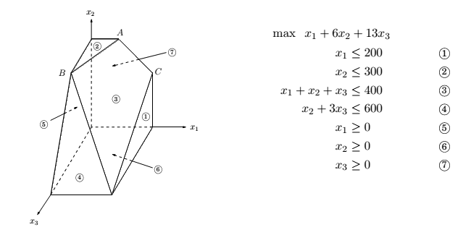
A polyhedron defined by seven inequalities

Slide 29
Vertices and neighbors in n-dimensional space
Deﬁnition
Each vertex is the unique point at which some subset of hyperplanes meet.
Pick a subset of the inequalities. If there is a unique point that satisﬁes them with equality, and this point happens to be feasible, then it is a vertex.
Each vertex is speciﬁed by a set of n inequalities.
Deﬁnition
Two vertices are neighbors if they have n − 1 deﬁning inequalities in common.

Slide 30
The algorithm
On each iteration, simplex has two tasks:
1. Check whether the current vertex is optimal (and if so, halt);
2. Determine where to move next.
As we will see, both tasks are easy if the vertex happens to be at the origin. And if the vertex is elsewhere, we will transform the coordinate system to move it to the origin!

Slide 31

The convenience for the origin
Suppose we have some generic LP:
where x is the vector of variables, x = (x₁,...,x_{n}).
Suppose the origin is feasible. Then it is certainly a vertex, since it is the unique point at which the n inequalities
x₁ ≥ 0,...,x_{n} ≥ 0
are tight.

Slide 32
Task 1 in the origin
Lemma
The origin is optimal if and only if all c_{i} ≤ 0. (We need b > 0)
Proof.
If all c_{i} ≤ 0, then considering the constraints x ≥ 0, we can’t hope for a better objective value.
Conversely, if some c_{i} > 0, then the origin is not optimal, since we can increase the objective function by increasing some x_{i}.

Slide 33
Task 2 in the origin
We can move by increasing some x_{i} for which c_{i} > 0.
How much can we increase it?
Until we hit some other constraint. That is, we release the tight constraint x_{i} ≥ 0 and increase x_{i} until some other inequality, previously loose, now becomes tight.
At that point, we again have exactly n tight inequalities, so we are at a new vertex.

Slide 34
What if our current vertex u is elsewhere?
The trick is to transform u into the origin, by shifting the coordinate system from the usual (x₁,...,x_{n}) to the “local view” from u.
These local coordinates consist of (appropriately scaled) distances y₁,...,y_{n} to the n hyperplanes (inequalities) that deﬁne and enclose u.
Speciﬁcally, if one of these enclosing inequalities is a_{i} ·x ≤ b_{i},
then the distance from a point x to that particular “wall” is
y_{i} = b_{i}− a_{i}· x.
The n equations of this type, one per wall, deﬁne the y_{i}’s as linear functions of the x_{i}’s, and this relationship can be inverted to express the x_{i}’s as a linear function of the y_{i}’s.

Slide 35

Rewriting the LP
Thus we can rewrite the entire LP in terms of the y’s.
This doesn’t fundamentally change it (for instance, the optimal value stays the same), but expresses it in a diﬀerent coordinate frame.
The revised “local” LP has the following three properties:
1. It includes the inequalities y ≥ 0, which are simply
the transformed versions of the inequalities deﬁning u.
2. u itself is the origin in y-space.
3. The cost function becomes max , where c_{u} is the value of the objective function at u and is a transformed cost vector.

Slide 36
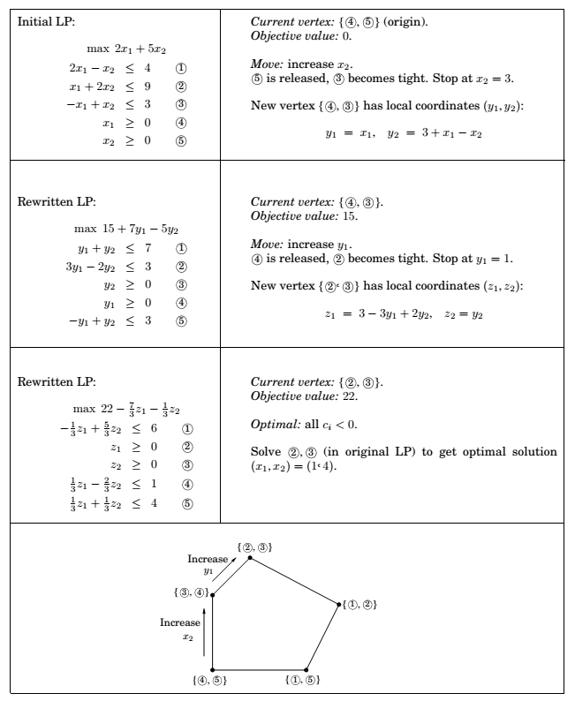

Slide 37
The starting vertex
In a general LP, the origin might not be feasible and thus not a vertex at all.
However, it turns out that ﬁnding a starting vertex can be reduced to an LP and solved by simplex!
Start with any linear program in standard form:
min c^{T}x such that Ax = b and x ≥ 0.

Slide 38
The starting vertex (cont.)
We ﬁrst make sure that the right-hand sides of the equations are all
nonnegative: if b_{i} < 0, just multiply both sides of the ith equation by -1.
Then we create a new LP as follows:
Create m new artiﬁcial variables z₁,...,z_{m} ≥ 0, where m is the number of equations.
Add z_{i} to the left-hand side of the ith equation.
Let the objective, to be minimized, be z₁ + z₂ + ··· + z_{m}.

Slide 39
The starting vertex (cont’d)
For this new LP, it’s easy to come up with a starting vertex, namely, the one with z_{i} = b_{i} for all i and all other variables zero.
Therefore we can solve it by simplex, to obtain the optimum solution. There are two cases:
If the optimum value of z₁ + z₂ + ··· + z_{m} is zero, then all z_{i}’s obtained by simplex are zero, and hence from the optimum vertex of the new LP we get a starting feasible vertex of the original LP, just by ignoring the z_{i}’s.
If the optimum objective turns out to be positive: We tried to minimize the sum of the z_{i}’s, but simplex decided that it cannot be zero. But this means that the original linear program is infeasible: it needs some nonzero z_{i}’s to become feasible.

Slide 40
Degeneracy
A vertex is degenerate if it is the intersection of more than n faces of the polyhedron, say n+1.
Algebraically, it means that if we choose any one of n sets of n+1 inequalities and solve the corresponding system of n linear equations in n unknowns, we’ll get the same solution in all n+1 cases.
This is a serious problem: simplex may return a suboptimal degenerate vertex simply because all its neighbors are identical to it and thus have no better objective.
And if we modify simplex so that it detects degeneracy and continues to hop from vertex to vertex despite lack of any improvement in the cost, it may end up looping forever.

Slide 41
Degeneracy (cont’d)
One way to ﬁx this is by a perturbation:
change each b_{i} by a tiny random amount to b_{i} ± ε_{i}.
This doesn’t change the essence of the LP since the ε_{i}’s are tiny, but it has the eﬀect of diﬀerentiating between the solutions of the linear systems.

Slide 42
Unboundedness
In some cases an LP is unbounded, in that its objective function can be made arbitrarily large (or small, if it’s a minimization problem).
If this is the case, simplex will discover it: in exploring the neighborhood of a vertex, it will notice that taking out an inequality and adding another leads to an underdetermined system of equations that has an inﬁnity of solutions.
And in fact (this is an easy test) the space of solutions contains a whole line across which the objective can become larger and larger, all the way to ∞.
In this case simplex halts and complains.

Slide 43
The running time of simplex
What is the running time of simplex, for a generic linear program:
max c^{T}x such that Ax ≤ 0 and x ≥ 0.
where there are n variables and A contains m inequality constraints?
It is an iterative algorithm that proceeds from vertex to vertex.
Let u be the current vertex, i.e., unique point at which n inequality constraints are satisﬁed with equality. Each of its neighbors shares n−1 of these inequalities, so u can have at most n · m neighbors.

Slide 44
The running time of simplex (cont.)
A naive way for an iteration: (1) check each potential neighbor to see whether it really is a vertex of the polyhedron, (2) determine its cost.
(2) is easy. (1) involves: solve a system of n equations and check whether the result is feasible.
By Gaussian elimination this takes O(n³) time, giving total O(mn⁴) per iteration.

Slide 45
The running time of simplex (cont’d)
A much better way: the mn⁴ can be improved to mn.
Recall the local view from vertex u. The per-iteration overhead of rewriting the LP in terms of the current local coordinates is just O((m +n)n); since the local view changes only slightly between iterations, in just one of its deﬁning inequalities.
Next, to select the best neighbor, we recall that the (local view of) the objective function is of the form
where c_{u} is the value of the objective function at u.

Slide 46
The running time of simplex (cont’d)
This immediately identiﬁes a promising direction to move: we pick any (if there is none, then the current vertex is optimal and simplex halts).
Since the rest of the LP has now been rewritten in terms of the y-coordinates, it is easy to determine how much y_{i} can be increased before some other inequality is violated. (And if we can increase y_{i} indeﬁnitely, we know the LP is unbounded.)

Slide 47
The running time of simplex (cont’d)
How many iterations could there be?
At most
i.e., the number of vertices.
It is exponential in n. And in fact, there are examples of LPs for which simplex does indeed take an exponential number of iterations.
Simplex is an exponential-time algorithm.
However, such exponential examples do not occur in practice, and it is this fact that makes simplex so valuable and so widely used.

Slide 48
Postscript: circuit evaluation

Slide 49
An ultimate application
We are given a Boolean circuit, that is, a dag of gates of the following types.
Input gates have indegree zero, with value true or false.
AND gates and OR gates have indegree 2.
NOT gates have indegree 1.
In addition, one of the gates is designated as the output.
The CIRCUIT VALUE problem is the following: when the laws of Boolean logic are applied to the gates in topological order, does the output evaluate to true?

Slide 50
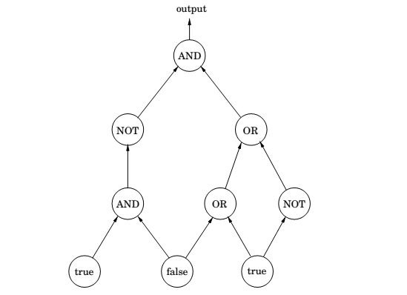
Circuit evaluation

Slide 51
LP formulation
Create a variable x_{g} for each gate g, with constraints 0 ≤ x_{g} ≤ 1.
Add additional constraints for each type of gate:
true gate: x_{g} = 1.
false gate: x_{g} = 0.
OR gate with inputs h and h’ : x_{g} ≥ x_{h} , x_{g} ≥ x_{h’} , x_{g} ≤ x_{h} + x_{h’} .
AND gate with inputs h and h’ : x_{g} ≤ x_{h} , x_{g} ≤ x_{h’} , x_{g} ≥ x_{h} + x_{h’} − 1.
NOT gate with input h: x_{g} = 1 − x_{h}.
These constraints force all the gates to take on exactly the right values – 0 for false, and 1 for true. We don’t need to maximize or minimize anything, and we can read the answer oﬀ from the variable x_{o} corresponding to the output gate.

Slide 52
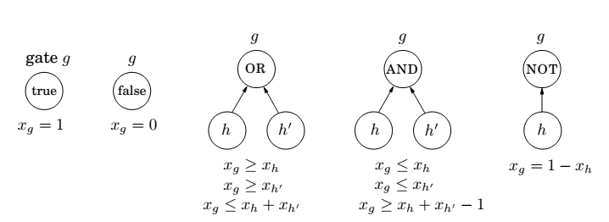
Circuit evaluation

Slide 53
The generality
The CIRCUIT VALUE problem is in a sense the most general problem solvable in polynomial time!
After all, any algorithm will eventually run on a computer, and the computer is ultimately a Boolean combinational circuit implemented on a chip.
If the algorithm runs in polynomial time, it can be rendered as a Boolean circuit consisting of polynomially many copies of the computer’s circuit, one per unit of time, with the values of the gates in one layer used to compute the values for the next.
Hence, the fact that CIRCUIT VALUE reduces to linear programming means that all problems that can be solved in polynomial time do!

